Slide 1
AN ANALYSIS TO FACILITATE THE STRATEGIC GROWTH OF BUSINESS OPERATIONS IN RIBY THROUGH THE PRIROTIZATION OF BUSINESS ACTIVITIES

Slide 2
INTRODUCTION
Riby is a FinTech company that offers automated financial management services for cooperatives and their members. Its main focus is to provide channels for easy savings and lending system to its customers.
Following the growth and expansion of the business operations of Riby over the years, the management is looking at prioritizing its investments across different regions.
Portfolio Managers and Regional managers have made their recommendations on the strategic priorities to be adopted and incorporated into the business operations.
However, Top Management is not impressed with their recommendations and projections and have demanded for a detailed analysis of past business operations to make a more informed decision.

Slide 3
AIM OF ANALYSIS
This Study aims to determine the strategic priorities of Riby.
OBJECTIVES
Analyze and visualize different scenarios to support elaboration of business development strategies.
Give recommendations and consultations regarding questions of development of other departments and general company organization.
Guide stakeholders to make strategic decisions and incorporate them into the strategy management process

Slide 4
The dataset is based on a 500,000 data set of previous transactions which represent orders across different regions. From the dataset provided we will be analyzing and visualizing using PowerBI:

Slide 5
SUMMARY OF DATA
Total Revenue | Total Cost | Total Profit | Total Item Type | Total Regions | Total Countries | Total Units Sold | Total Years
665.05bn | 468.81bn | 196.24bn | 12 | 7 | 185 | 2bn | 8

Slide 6

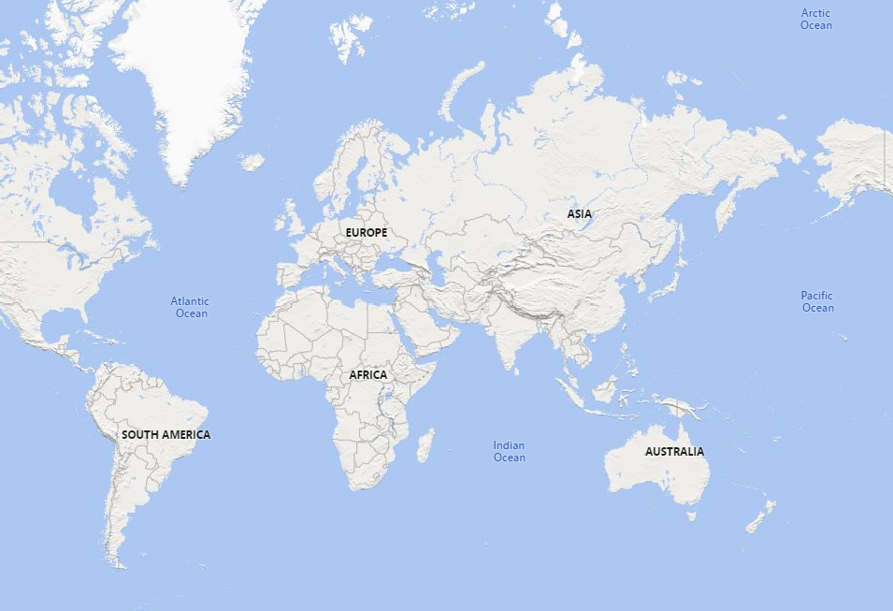
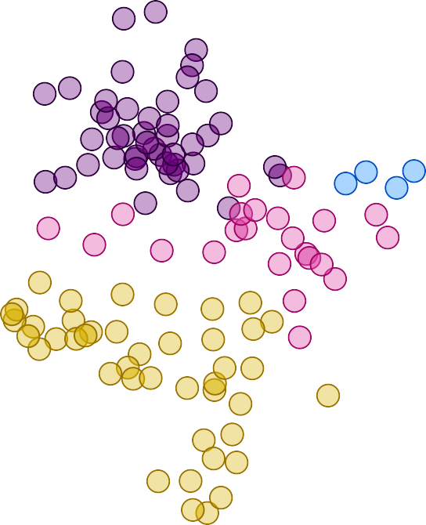



Country and Region
Power BI Desktop
Region Asia
Australia and Oceania
Central America and the Caribbean Europe
Middle East and North Africa North America
Sub-Saharan Africa

Slide 7
Power BI Desktop
Region | Sum of Total Revenue | Sum of Total Cost  | Sum of Total Profit
Sub-Saharan Africa | 173,560,299,942.93 | 122,359,316,220.91 | 51,200,983,722.02
Europe | 171,541,287,266.67 | 120,912,182,515.89 | 50,629,104,750.78
Asia | 96,816,201,634.51 | 68,223,081,497.16 | 28,593,120,137.35
Middle East and North Africa | 82,645,567,278.45 | 58,286,181,321.65 | 24,359,385,956.80
Central America and the Caribbean | 71,984,170,286.13 | 50,735,286,009.82 | 21,248,884,276.31
Australia and Oceania | 53,948,083,069.56 | 38,012,088,416.59 | 15,935,994,652.97
North America | 14,552,545,512.55 | 10,280,036,714.56 | 4,272,508,797.99
Total | 665,048,154,990.80 | 468,808,172,696.58 | 196,239,982,294.22

Slide 8
Power BI Desktop
100%
Sub-Saharan Africa
Europe Asia
Middle East and North Africa Central America and the Caribbean Australia and Oceania
North America
51.20bn
50.63bn
28.59bn
24.36bn
21.25bn
15.94bn
4.27bn
8.3%
100%
Sub-Saharan Africa Europe
Asia
Middle East and North Africa Central America and the Caribbean Australia and Oceania
North America
173.56bn
171.54bn
96.82bn
82.65bn
71.98bn
53.95bn
14.55bn
8.4%

Slide 9
Power BI Desktop
 | Region  | %GT Sum of Total Revenue | %GT Sum of Total Cost | %GT Sum of Total Profit | Sum of Units Sold
 | Asia | 14.56% | 14.55% | 14.57% | 364122959
 | Australia and Oceania | 8.11% | 8.11% | 8.12% | 202896949
 | Central America and the Caribbean | 10.82% | 10.82% | 10.83% | 269684393
 | Europe | 25.79% | 25.79% | 25.80% | 646416168
 | Middle East and North Africa | 12.43% | 12.43% | 12.41% | 310359376
 | North America | 2.19% | 2.19% | 2.18% | 54235843
 | Sub-Saharan Africa | 26.10% | 26.10% | 26.09% | 651852367
 | Total | 100.00% | 100.00% | 100.00% | 2499568055
o…
200bn
150bn 100bn
Sum of Total Revenue Sum of Total Cost Sum of Total Profit
50bn
0bn
Sub-Sahar… Africa
Europe
Asia
Middle East and North Africa
Central America and the Caribbean
Australia and Oceania
North America
Region

Slide 10
Sum of Total Revenue, Sum of Total Cost and Sum of Total Profit by Year
Power BI Desktop
t
80bn
60bn
Sum of Total Revenue Sum of Total Cost
Sum of Total Profit
40bn
20bn
0bn
2010
2011
2012
2013
2014
2015
2016
2017
Year

Slide 11

Sum of Total Revenue, Sum of Total Cost and Sum of Total Profit by Item Type
Power BI Desktop
140bn
120bn 100bn 80bn
Sum of Total Revenue, Sum of Total Cost and Sum of Total Profit
60bn
Sum of Total Revenue Sum of Total Cost Sum of Total Profit
40bn
20bn
0bn
Meat
Cereal
Snacks
Clothes
Fruits
Household
Cosmetics
Baby Food
Vegetables
Personal Care
Beverages
Office Supplies

Slide 12

Sum of Total Revenue by Item Type and Region
Power BI Desktop
140bn
120bn 100bn
Sum of Revenue
80bn
Region
Asia
Australia and Oceania
Central America and the Caribbean Europe
Middle East and North Africa North America
Sub-Saharan Africa
60bn
40bn
20bn
0bn
Household
Cosmetics
Meat
Baby Food
Cereal
Vegetables
Snacks
Clothes
Beverages
Fruits
Office Supplies
Personal Care
I

Slide 13

e
Power BI Desktop
40bn
30bn 20bn 10bn 0bn
t
Cosmetics
Household
Baby Food
Cereal
Clothes
Vegetables
Meat
Snacks
Beverages
Fruits
Office Sup…
Personal Care
I
Sum of Total Revenue by Item Type
100bn
50bn 0bn
Household
Office Su…
Cosmetics
Meat
Baby Food
Cereal
Vegetables
Snacks
Clothes
Personal …
Beverages
Fruits
Item Type

Slide 14

e
Power BI Desktop
10bn
8bn
Item Type Baby Food Beverages
Cereal Clothes Cosmetics Fruits Household Meat
Office Supplies Personal Care Snacks Vegetables
t
6bn
4bn
2bn
0bn
Sub-Saharan Africa
Europe
Asia
Middle East and North Africa
Central America and the Caribbean
Australia and Oceania
North America

Slide 15
RESULTS
1. Sub-Saharan Africa had the highest Sum of Total Revenue and was 1,092.65% higher than North America, which had the lowest Sum of Total Revenue
2. Sub-Saharan Africa accounted for 26.10% of Sum of Total Revenue.
3. Across all metrics, Sum of Total Cost had the most interesting recent trend and started trending down on 2013, falling by 43.16% (26,789,873,142.76) in 4 years. [] Sum of Total Cost dropped from 62,070,652,820.77 to 35,280,779,678.01 during its steepest decline between 2013 and 2017.
4. , Cosmetics had the highest Sum of Total Profit and was 7,153.63% higher than Fruits, which had the lowest Sum of Total Profit at 499,972,690.68. [] Cosmetics accounted for 18.48% of Sum of Total Profit.

Slide 16
CONCLUSION
The data analysis reveals that Sub Saharan Africa is the region with the highest revenue and profit margin.
Under Item Type- Cosmetics has the highest profit margin and general high turnover in all regions, followed by Household items and office supplies.

Slide 17
RECOMMENDATION
More resources should be directed towards increasing the sales margin in Sub Saharan Africa.
There should also be more investment in cosmetics which yields more profit.
Business Development Units should re-strategise and submit proposal for elaborating of short-term and long-term business plans in areas of low sales margin.

Slide 18
PRESENTED AND COMPILED BY:
ATUORAH MONICA CHINELO
Data Science Sub Group C

